Slide 1
Theory of Automata
Lecture # 09
Imtiaz Ahmed
sites.google.com/site/kiuskardu

Slide 2
Transition Graphs TG (Non Deterministic Finite Automata)
TG's can have more than one initial state
In TG's, Edges/transitions can be labeled with strings
In TG's, it is not necessary to show transitions for all letters

Slide 3
Transition Graphs
In FA, there is always one start state but in TG, there can be one or more start states. In FA, there must be one transition for every letter on every state and each transition is labelled by single letter. It means that after reading a letter, an FA can move from one state to another. But in TG, we can also use a letter as well as a sub-string as a label of a transition and by reading that sub-string, it can move from one state to another state

Slide 4
Nondeterminism
TGs and GTGs provide certain relaxations as compare to FAs
In TGs and GTGs there may exist more than one path for a certain string or there may not be any path for a certain string
This property creates nondeterminism and it can also help in differentiating TGs or GTGs from FAs.
Therefore an FA is also called a Deterministic Finite Automaton (DFA).

Slide 5
Kleene’s Theorem
Kleene’s Theorem Part I
If a language can be accepted by an FA then it can be accepted by a TG as well.
Kleene’s Theorem Part II
If a language can be accepted by a TG then it can be expressed by an RE as well.
Kleene’s Theorem Part III
If a language can be expressed by a RE then it can be accepted by an FA as well

Slide 6
Kleene’s Theorem
Proof (Kleene’s Theorem Part I)
Since every FA can be considered to be a TG as well, therefore there is nothing to prove.

Slide 7
Finite Automata (FA)
Definition
A Finite automaton (FA), is a collection of the
followings
Finite number of states, having one initial and some (maybe none) final states.
Finite set of input letters (Σ) from which input strings are formed.
Finite set of transitions i.e. for each input letter there is a transition showing how to move from one state to another.

Slide 8
Transition Graph
Definition
A Transition graph (TG), is a collection of the followings
Finite number of states, at least one of which is start state and some (maybe none) final states.
Finite set of input letters (Σ) from which input strings are formed.
Finite set of transitions that show how to go from one state to another based on reading specified substrings of input letters, possibly even the null string (Λ).

Slide 9
Proof(Kleene’s Theorem Part II)
To prove part II of the theorem, an algorithm consisting of different steps, is explained showing how a RE can be obtained corresponding to the given TG.
For this purpose the TG is changed to that of GTG i.e. the labels of transitions are corresponding REs.

Slide 10
Proof(Kleene’s Theorem Part II) (Contd..)
Basically this algorithm converts the given TG to GTG
with one initial state along with a single loop OR
One initial state connected with one final state by a single transition edge.
The label of the loop or the transition edge will be the required RE.

Slide 11
Proof(Kleene’s Theorem Part II) (Contd..)
Step 1
If a TG has more than one start states, then
Introduce a new start state connecting the new state to the old start states by the transitions labeled by Λ
Make the old start states the non-start states.
This step can be shown by the example in the next slide

Slide 12
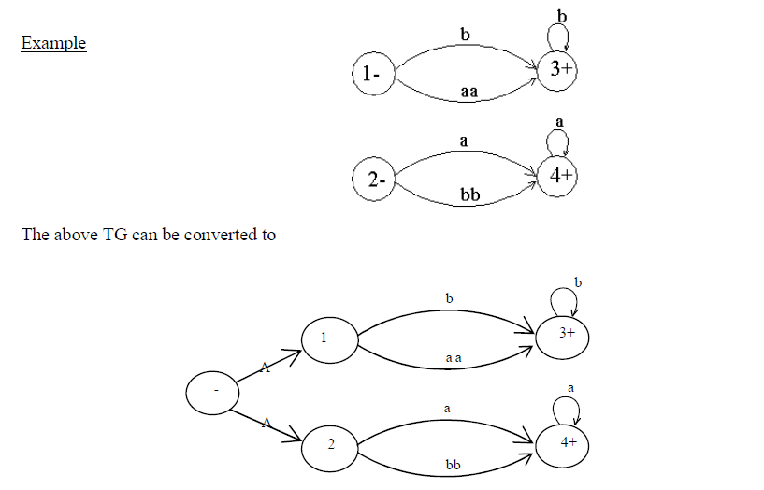
Proof(Kleene’s Theorem Part II) (Contd..) Step 1

Slide 13
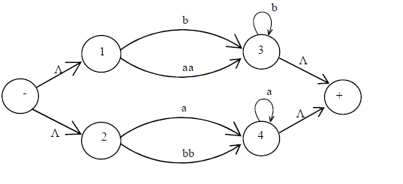
Proof(Kleene’s Theorem Part II) (Contd..)
Step 2:
If a TG has more than one final states, then
Introduce a new final state, connecting the old final states to the new final state by the transitions labeled by Λ.

Slide 14
Proof(Kleene’s Theorem Part II) (Contd..)
Step 3:
If a state has two (more than one) incoming transition edges labeled by the corresponding REs, from the same state (including the possibility of loops at a state), then
Replace all these transition edges with a single transition edge labeled by the sum of corresponding REs.
Example in the next slide will explain this step clearly

Slide 15
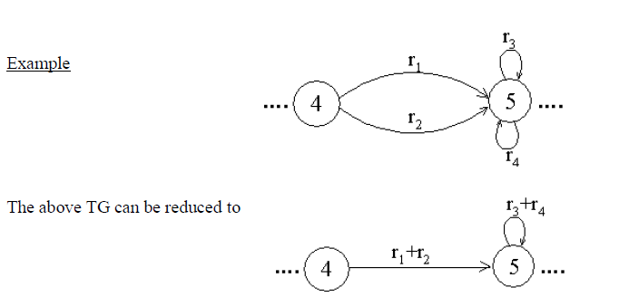
Proof(Kleene’s Theorem Part II) (Contd..)
Step 3 (contd..):

Slide 16
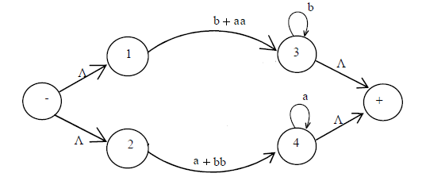
Proof(Kleene’s Theorem Part II) (Contd..)
Step 3 (contd..):

Slide 17
Proof(Kleene’s Theorem Part II) (Contd..)
Step 4 (bypass and state elimination)
If three states in a TG, are connected in sequence then
Eliminate the middle state and connect the first state with the third by a single transition (include the possibility of circuits and loops as well) labeled by the RE which is the concatenation of corresponding two REs in the existing sequence.

Slide 18
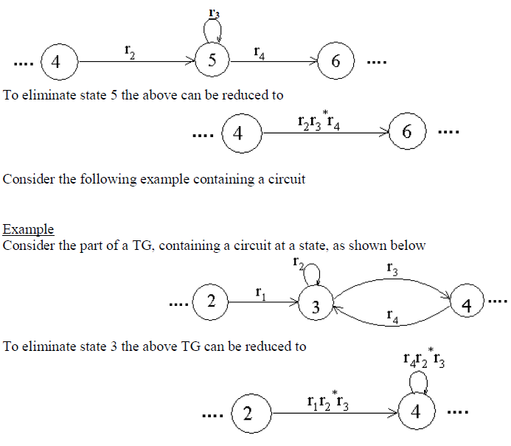
Proof(Kleene’s Theorem Part II) (Contd..)
Step 4 (Example)

Slide 19
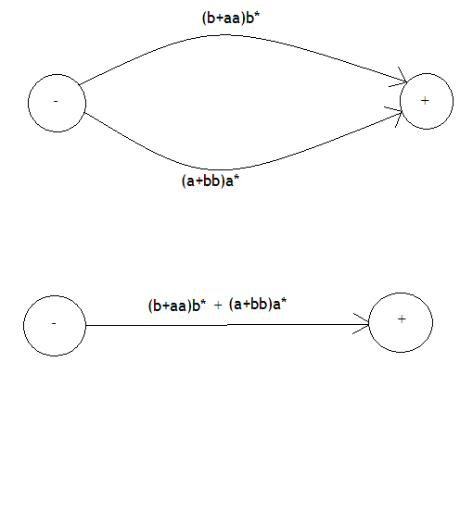
Proof(Kleene’s Theorem Part II) (Contd..)
Step 4 (bypass and state elimination)

Slide 20

Thanks!

